Slide 1
ASSESSMENT: RICKY’S RIDES
Portfolio for 3.7 / 3.8
Tame Perenara

Slide 2
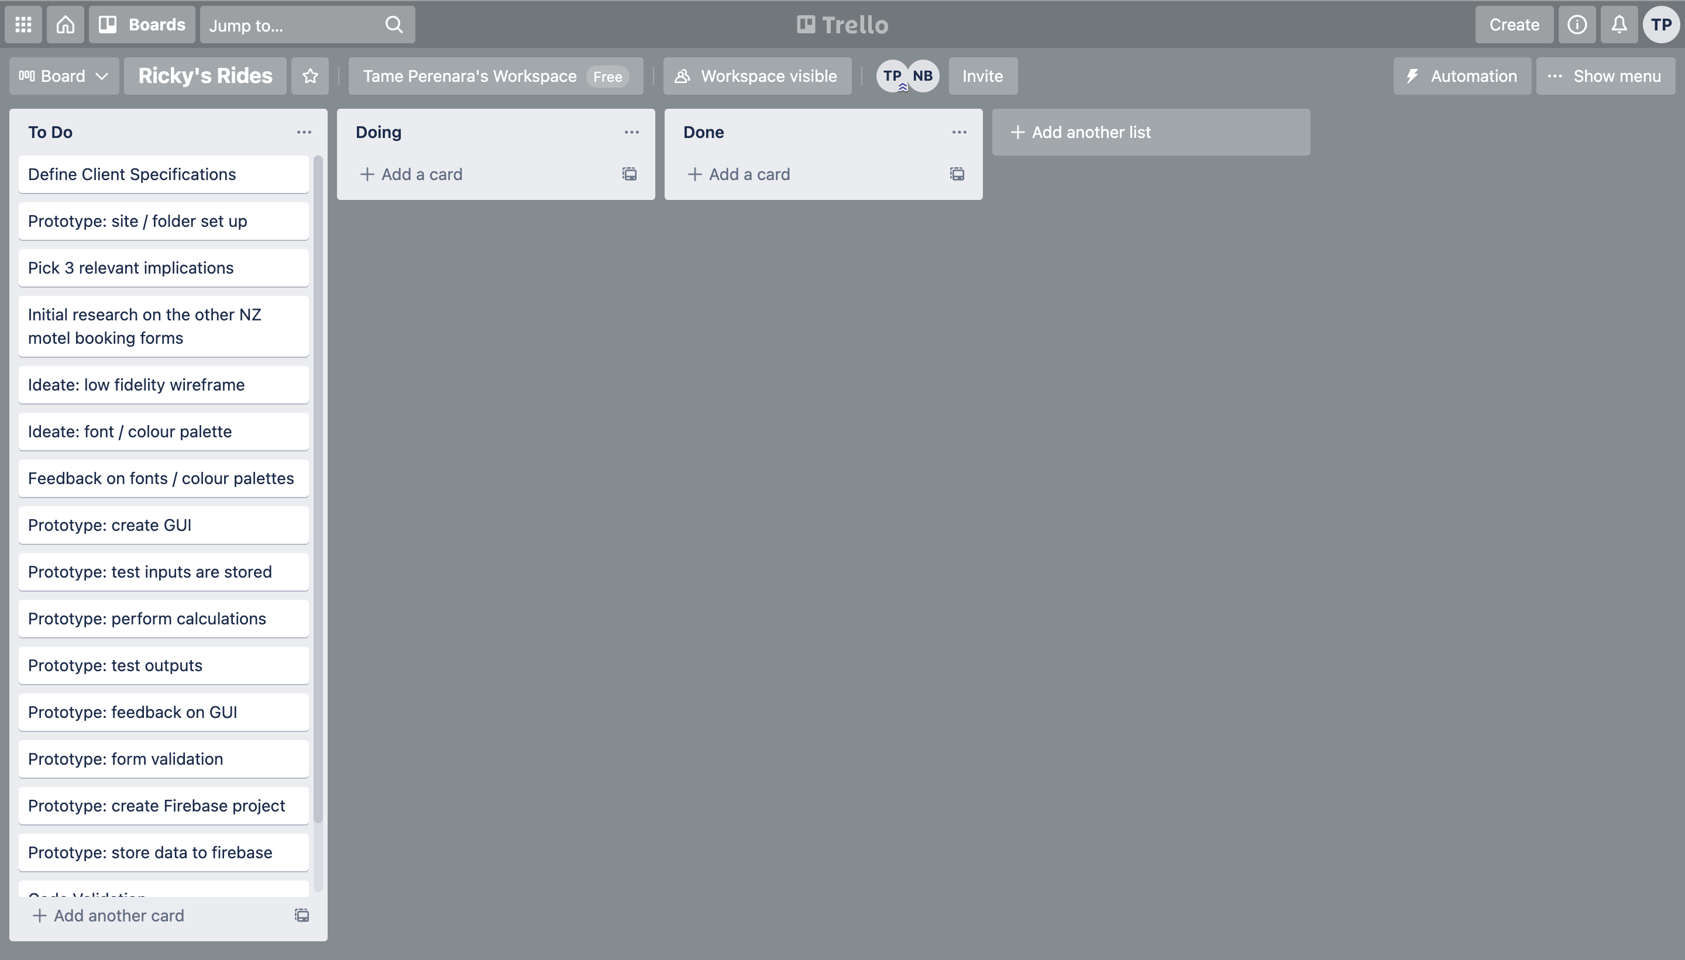
CREATE PROJECT MANAGEMENT TOOLS
Notes:
Share the link here

Slide 3
STEP 1 : DEFINE YOUR RELEVANT IMPLICATIONS
What are 3 relevant implications you will be focusing on?
Aesthetics: Aesthetics is a core design principle that defines a design's pleasing qualities. In visual terms, aesthetics includes factors such as balance, colour, movement, pattern, scale, shape and visual weight. Designers use aesthetics to complement their designs' usability, and so enhance functionality with attractive layouts.
Functionality: Website functionality is defined by the ease of how a user can navigate your site, get the information they are seeking, and/or purchase the product they want. A few ways to improve your website functionality include Simple, well-defined navigation. Easy-to-understand web design and clear user experience.
Usability: In web design, usability refers to how easy a website is for visitors to interact with. For example, some sites are visually stunning but difficult to navigate, which makes it hard for users to find what they need. Usability is about functionality, while UX is (as the name suggests) about experience.

Slide 4
STEP 1 : DEFINE YOUR AUDIENCE
Who is your target audience?
My target audience for this website is users interested in renting vehicles form Ricky’s Rides. Anyone can acquire the rentals; however, the client wants to reservations with people flying into Dunedin Airport.
How are they most likely going to be viewing your GUI?
The most common screen resolution across all devices is 1920x1080, meaning that most users will be on desktop, while the most common browsers are Chrome and Safari. Although this is the case my website needs to be fully scalable on all devices and be accessible on all browsers.

Slide 5
DEFINE THE KEY STEPS OF THIS PROJECT
Record the client specifications
Create Trello board to manage tasks
Ideate (wireframe (GUI), Google fonts / colours)
Prototype: Create the GUI, test inputs work, perform calculations, test outputs, form validation and error messages, create firebase project, connect to firebase and push data
Testing : ongoing and should involve A vs B testing with end users

Slide 6
PROJECT MANAGEMENT TOOL: TRELLO

Slide 7
PROJECT MANAGEMENT TOOL: TRELLO

Slide 8
CLIENTS SPECIFICATIONS
You have been hired to create an online reservation form for a local Car Rental Business in Dunedin called Ricky’s Rides. The owner (Ricky) is hoping to expand his business and by creating an online reservation system he will gain more reservations, particularly with people flying into Dunedin Airport. The reservation form will allow users to reserve a vehicle, Ricky has supplied a car list and some images of the cars. Extra items a user can add to their reservation includes:
- Snow chains - $60
- Roof racks - $90
- Bike rack (fits max 3 bikes) - $120
- GPS - $35
- Child Booster Seat (9kg -36kg) - $50
The total hire price is calculated by the vehicles price per day by the number of days the vehicle is hired for. You will need to add on a mandatory $20 per day insurance fee plus a one-off standard booking fee of $50. The reservations need to be stored in a real time database so that the manager can then approve bookings as they are created. The GUI must allow the program to book number of days (max 21 days) and their pick up date. The user must select where they want to pick up their car from: Ricky’s Rides Depot at 2 Arthur Street or Dunedin Airport. Create a text area for the users to add any additional comments. The location of this new business is going to be 2 Arthur Street Dunedin and their contact phone number is: 034775277 and email: rickeysrides@gmail.com. They want their colour palette to be white, orange, grey (as per their logo) and wish for it to be modern and sleek. The GUI should include a header with their logo and contact details in a footer. Ensure the reservation form is mobile / tablet friendly. The GUI should present a summary of their reservation and output a text confirmation once the reservation has submitted, it should saying reservation confirmed and has been sent to their email address. Error messages should be user friendly and allow users to recover from their error messages.
The Programs Specifications
- The top of the page must contain their Company name and logo heading
- A footer containing their contact details
- The GUI should clearly display each of the vehicles with a photo, daily hire price and their corresponding description
- The user should then be allowed to select a vehicle
- Allow users to select from extra options (listed above)
- Select their number of days – number input (max 21)
- Pick up date – date input
- Pickup location – Dunedin Airport or Ricky’s Rides Depot (radio buttons)
- A reservation summary which outputs the detail of their reservation with an itemised breakdown of the total cost (e.g price of vehicle, insurance, booking fee etc)
- A button to confirm their reservation
- A checkbox that the user must tick to ensure they agree to our Terms and Conditions before proceeding to a confirmed reservation message
- The program must store all of the booking details to a real time firebase database
- The page should refresh after the reservation has been completed Once the user has selected their vehicle, allow them to add in their details
- First name
- Last name
- NZ Drivers License Number (2 letters follower by 6 numbers) e.g AB123456
- Age(you must be older than 25 to rent a car and less than 80 years old)
- Cell phone number
- Email address

Slide 9
STEP 2:IDEATE (LOW FIDELITY WIREFRAME)

Slide 10
WIREFRAME FEEDBACK

Slide 11
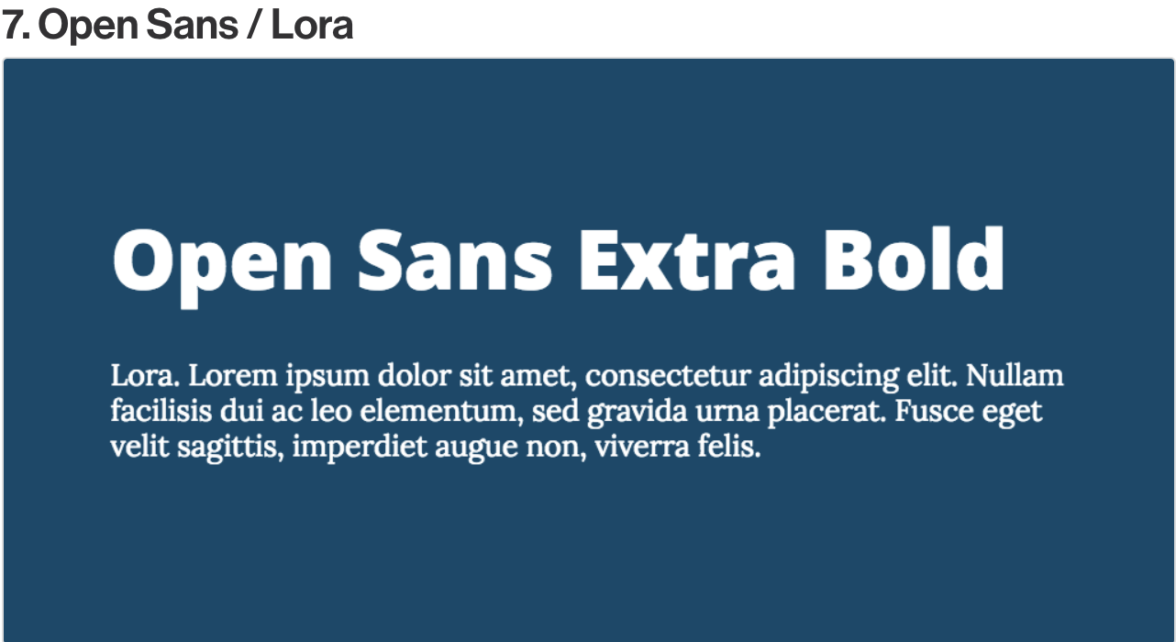
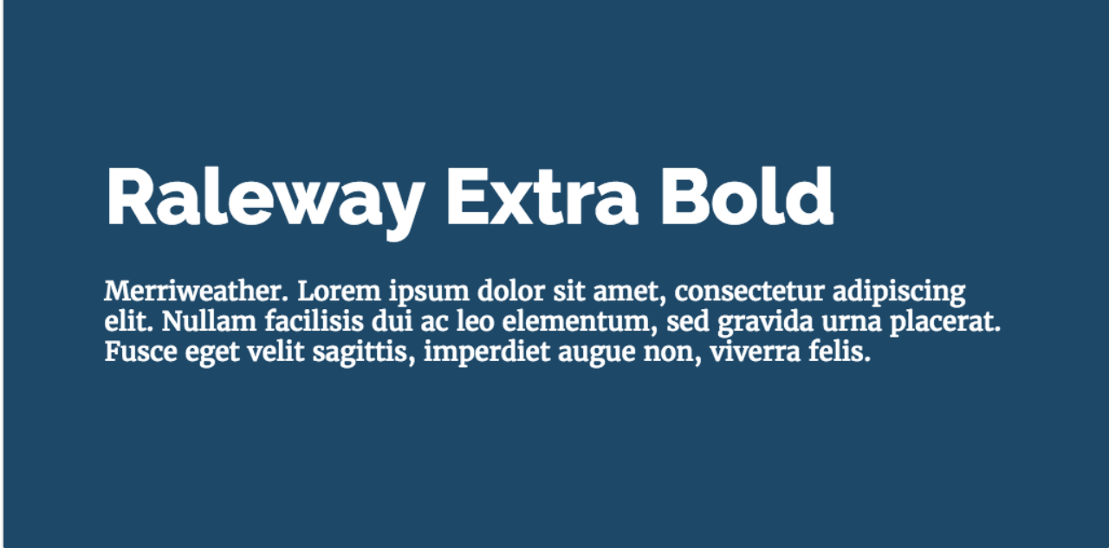
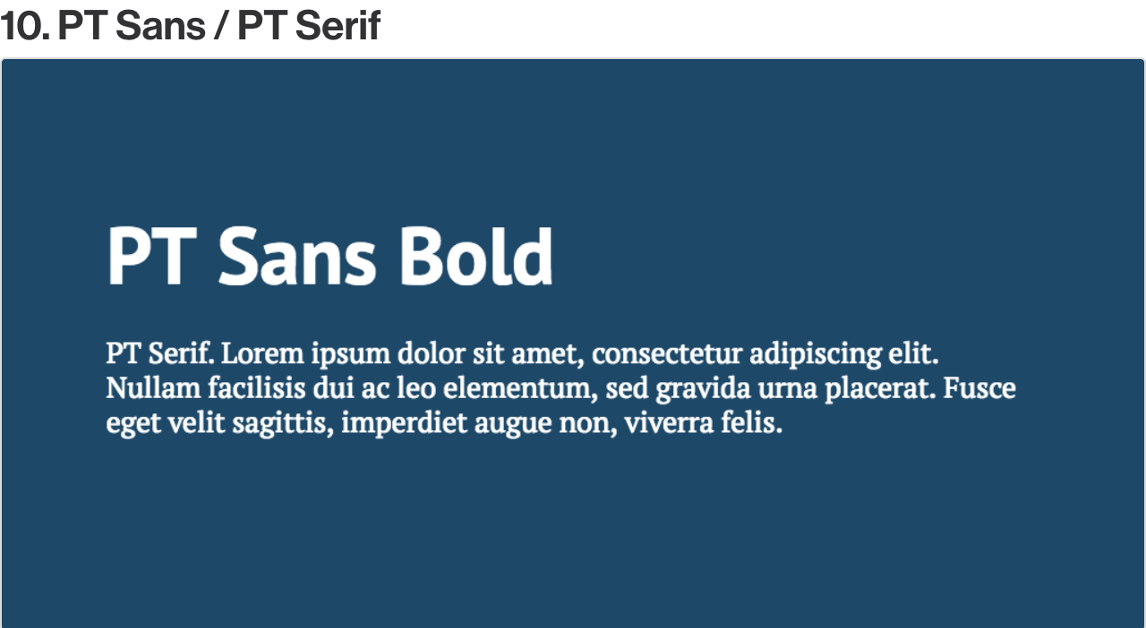
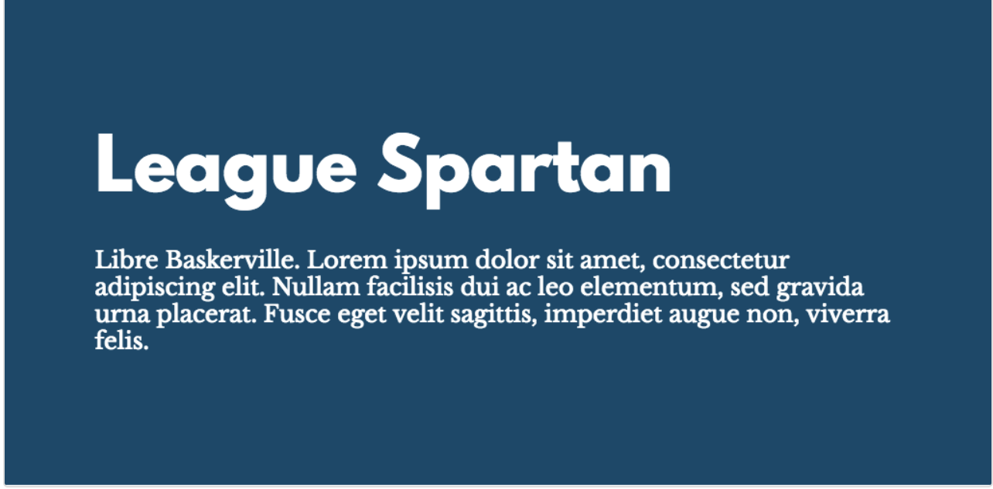
FONT COMBINATIONS
1
2
3
4

Slide 12
FEEDBACK ON FONTS
1)
2)
3)
4)

Slide 13
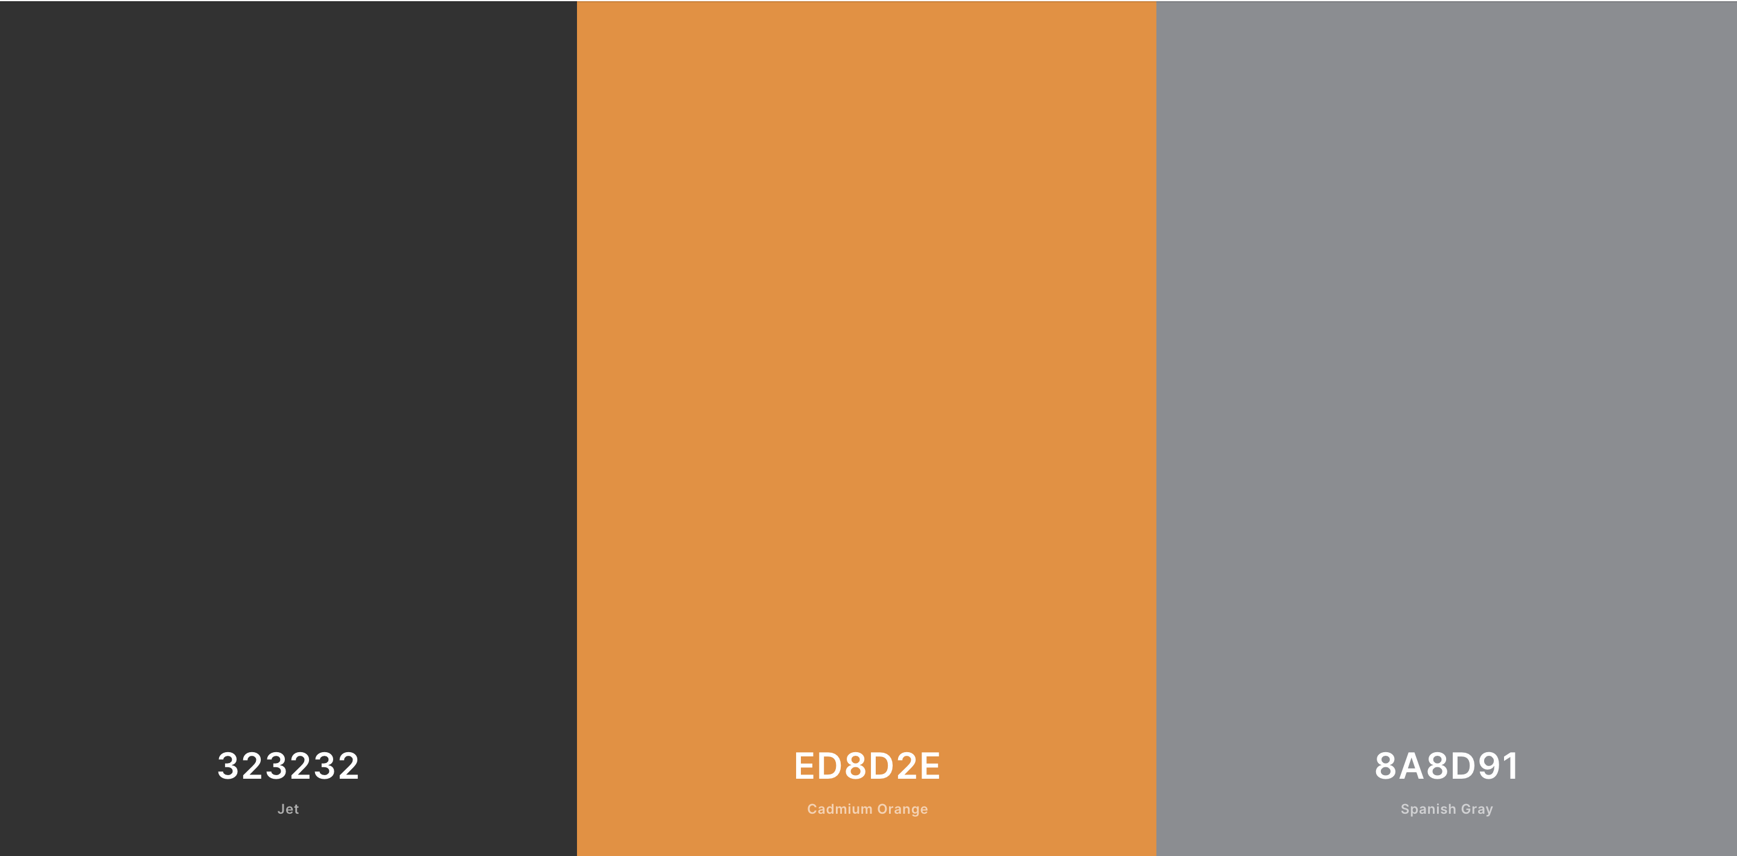
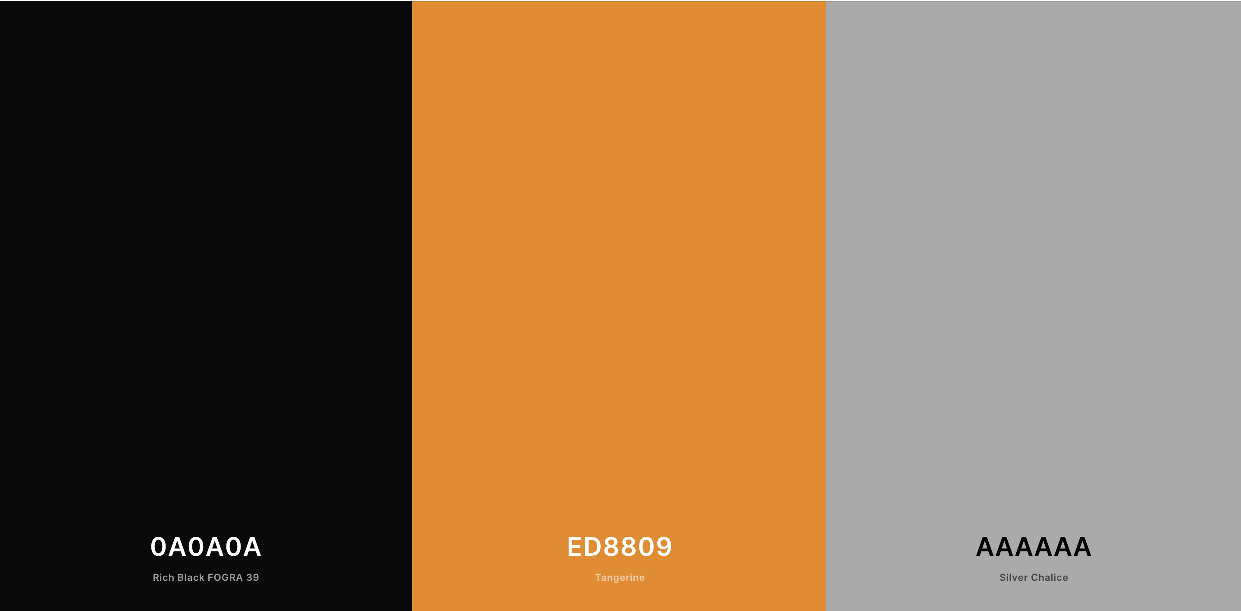
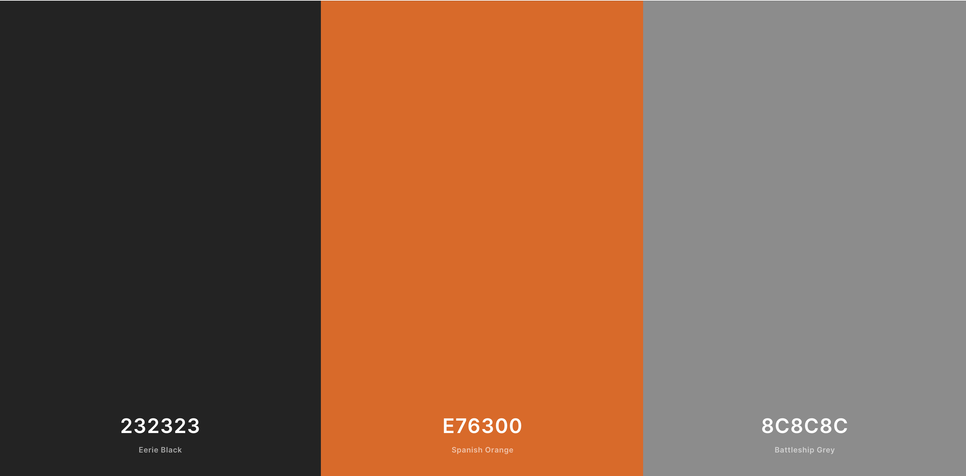
COLOUR PALETTES

Slide 14
SITE SET UP

Slide 15
SET UP THE GUI

Slide 16
TRIALING INPUTS

Slide 17
Every LESSON – TAKE A SCREENSHOT OF YOU USING YOUR TRELLO BOARD – ADDING NOTES TO YOUR CARDS ETC AND A SCREENSHOT OF YOUR CODE AND GUI

Slide 18
TRIALING INPUTS

Slide 19
FEEBACK ON THE FUNCTIONALITY

Slide 20
FEEBACK ON THE ASETHETHICS

Slide 21
FEEBACK ON THE USABILILTY

Slide 22
TRIALING LAYOUTS

Slide 23
TRIALING OUTPUTS / ERROR MESSAGES

Slide 24
TRIALING OUTPUTS / ERROR MESSAGES

Slide 25
IMPROVING THE FUNCTIONALITY

Slide 26
TRIALING OUTPUTS / ERROR MESSAGES

Slide 27
DEBUGGING : WORKS ON EXPECTED DATA

Slide 28
DEBUGGING : WORKS ON EXPECTED DATA

Slide 29
DEBUGGING : WORKS ON EXPECTED DATA

Slide 30
DEBUGGING : WORKS ON EXPECTED DATA

Slide 31
DEBUGGING : WORKS ON EXPECTED DATA

Slide 32
DEBUGGING : WORKS ON BOUNDARY DATA

Slide 33
DEBUGGING : WORKS ON BOUNDARY DATA

Slide 34
DEBUGGING : WORKS ON INVALID DATA

Slide 35
DEBUGGING : WORKS ON INVALID DATA

Slide 36
FEEDBACK ON GUI

Slide 37
REFINEMENTS

Slide 38
REFINEMENTS

Slide 39
PHONE VS TABLES VS DESKTOP SCALING

Slide 40
REFINEMENTS

Slide 41
EVIDENCE OF CODE VALIDATION (HTML)

Slide 42
EVIDENCE OF CODE VALIDATION (CSS)

Slide 43
EVIDENCE OF CODE VALIDATION (JS)

Slide 44
EVIDENCE OF CODE COMMENTS (HTML/CSS/JS)

Slide 45
PERSISTENT STORAGE (FIREBASE DATABASE) SETUP

Slide 46
PERSISTENT STORAGE (FIREBASE DATABASE)
Firebase database

Slide 47
PERSISTENT STORAGE (FIREBASE DATABASE)
Final video of testing evidence / split screened GUI with Firebase

